Slide 1

Exoplanet Detection Using Machine Learning
By
P. Krishna Balamohan 21481A05I1
P. Brahma Reddy 21481A05F8
M. Yuva Karthik 22485A0517
M. Durga Sai Sandeep 21481A05D5
P. Siva Sagar 21481A05G4
Under the guidance of Dr. T. Srinivasa Rao, | M.TECH, PhD
Professor, Department of Computer Science and Engineering.

Slide 2
OUTLINE
Abstract
Introduction
Objectives
Literature Review
Dataset (Kepler & TESS)
Preprocessing
Methodology
Machine Learning Models
Results

Slide 3
ABSTRACT
We developed a machine learning approach for exoplanet detection using data from the Kepler Space Mission. Our method focuses on pre-processing light curve data and selecting the best features using the Orange tool. Various machine learning models were tested, including Logistic Regression, K-Nearest Neighbors, Decision Tree, Random Forest, Gradient Boosting, XGBoost, and LightGBM. This approach automates and enhances the detection process, offering a scalable solution for larger datasets like TESS, improving the accuracy and efficiency of exoplanet detection.
Models Used
Logistic Regression
K-nearest Neighbors
Decision Tree Classifier
Random Forest Classifier
Gradient Boosting Classifier
Xgboost Classifier
Lightgbm Classifier

Slide 4
INTRODUCTION TO EXOPLANET DETECTION
Exoplanets: Planets orbiting stars outside our solar system.
Kepler Space Mission: Transit Method—detects brightness dips as planets transit stars.
Importance: Insights into planetary systems and habitability potential.
Role of Machine Learning: Automates classification, improves efficiency, and scales large datasets.

Slide 5
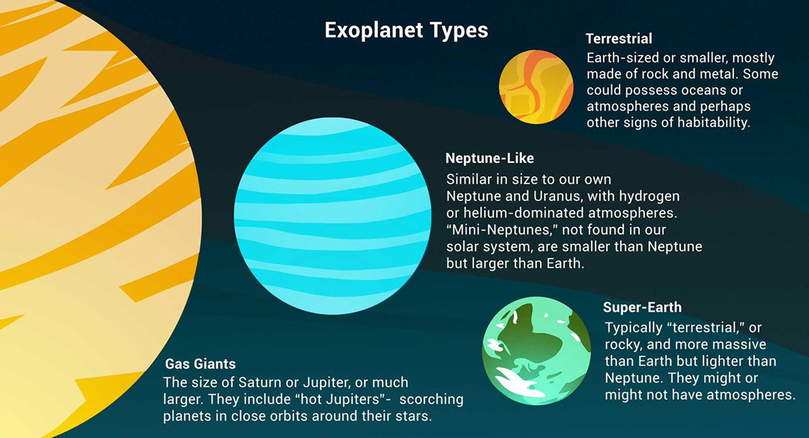

Slide 6
OBJECTIVES
Automate analysis of light curve data for exoplanet detection.
Enhance detection accuracy and precision beyond traditional methods.
Compare performance of various machine learning models on Kepler and TESS datasets.
Develop a scalable solution adaptable to future astronomical datasets.

Slide 7
LITERATURE REVIEW 1
Previous Studies:
Hogg et al. (2018): Applied deep learning to Kepler data, achieving 95% accuracy.
Lai et al. (2020): Utilized Support Vector Machines on noisy datasets, attaining high recall rates.
Oliviero et al. (2019): Demonstrated robustness of Random Forests in exoplanet detection.
Recent Advances:
University of Georgia (2023): Leveraged AI to identify exoplanets, highlighting machine learning's potential in astronomical discoveries.
USRA (2021): Discovered 69 new exoplanets using machine learning, marking a significant milestone in exploratory research.

Slide 8
LITERATURE REVIEW 2
Research Gaps Identified:
Manual detection methods are labor-intensive and time-consuming.
Machine learning models often struggle with noisy data, such as that from the TESS mission.
Limited comparative analyses of different machine learning models across various datasets.
Need for integration of synthetic data to enhance model training and detection accuracy.

Slide 9
DATASET
Kepler Dataset
Source: Kepler mission (NASA).
Duration: Collected over ~4 years.
Features:
Orbital period
transit depth
planetary radius
stellar temperature.
Dataset Volume: 15,000+ light curves.

Slide 10
KEPLER DATA COLUMN DESCRIPTIONS
Planetary Data
KepID: Kepler ID
KOI Name: Kepler Object of Interest
Kepler Name: Confirmed Kepler Name
Disposition: Archive Disposition
Score: Disposition Score
Period: Orbital Period (days)
Radius: Planet Radius (Earth radii)
Inclination: Orbital Inclination (°)
Equilibrium Temp: Planet Temp (K)
Transit Data
Epoch: Transit Epoch (BJD/BKJD)
Impact Param: Transit Impact Parameter
Depth: Transit Depth (ppm)
Duration: Transit Duration (hrs)
Ingress Duration: Ingress Time (hrs)
Signal-to-Noise: Transit SNR
Star Properties
Temp: Stellar Temp (K)
Gravity: Surface Gravity (log10 cm/s²)
Metallicity: Metallicity (dex)
Radius: Stellar Radius (Solar radii)
Mass: Stellar Mass (Solar mass)
Age: Stellar Age (Gyr)
Miscellaneous
RA/Dec: Right Ascension/Declination
Kepler Mag: Brightness in Kepler band
False Positives: Transit, Stellar, Centroid, Ephemeris

Slide 11
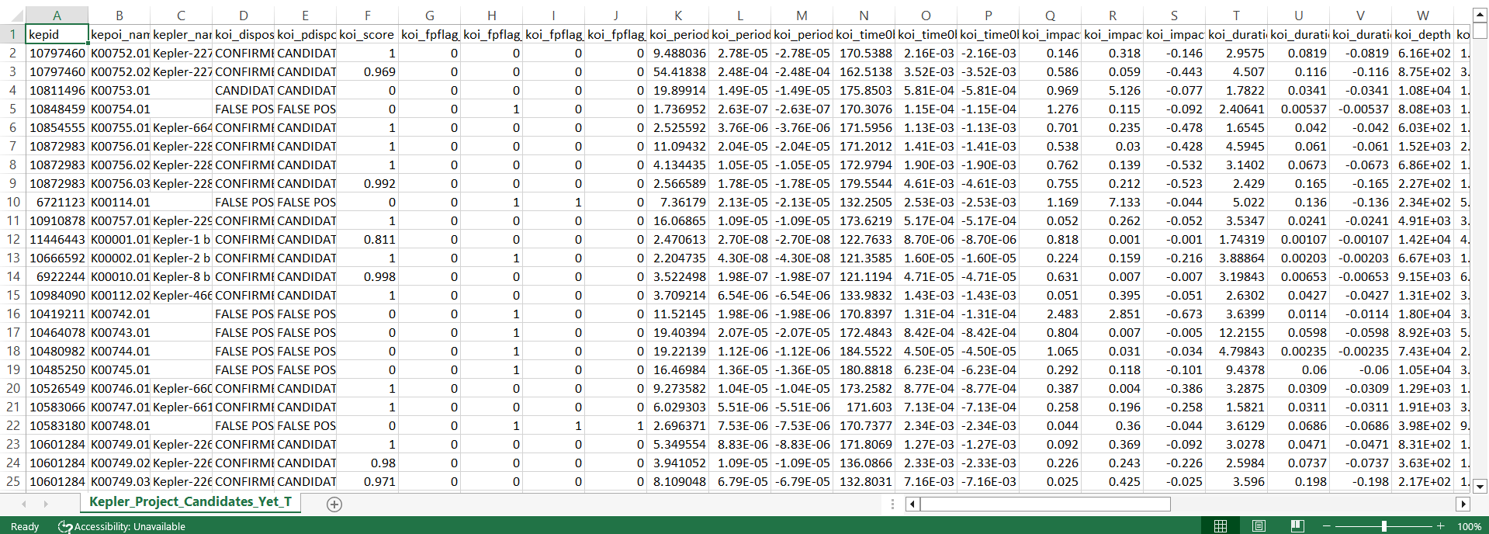
KEPLER DATASET

Slide 12
TESS DATASET
Source: TESS mission (NASA).
Duration: Shorter light curves (~27 days per sector).
Challenges:
-High noise levels due to short observation periods.
-Imbalanced classes with fewer confirmed exoplanets.
TIC ID: Unique identifier for the star observed by the TESS mission.
Planet Radius: Estimated size of the candidate exoplanet in terms of Earth's radius.
Orbital Period: Time the exoplanet takes to complete one orbit around its star.
Stellar Parameters: Information about the host star, such as its radius, mass, and temperature.
Transit Depth: How much light the exoplanet blocks when passing in front of its star.

Slide 13
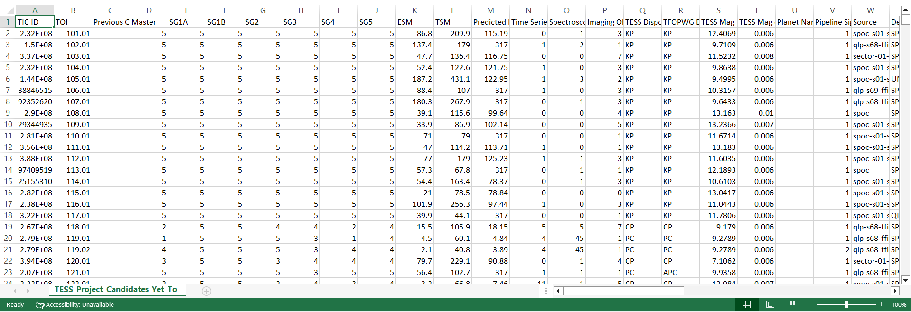
TESS DATASET

Slide 14
DATASET COMPARISON
Feature | Kepler | TESS
Duration | ~4 years | ~27 days
Observations | Millions | ~1 million/month
Noise Level | Low | High

Slide 15
PREPROCESSING
Steps Implemented:
Handling Missing Values: Imputed or removed to ensure data integrity.
Normalization: Standardized numerical features to a common scale.
Feature Selection: Identified and retained relevant features using the Orange tool.
Data Cleaning: Removed irrelevant columns and renamed for clarity.
TESS-Specific Adjustments:
Added "Confirmed" and "Candidate" columns to facilitate classification tasks.
Applied advanced noise reduction techniques to address higher noise levels.

Slide 16
FEATURE ENGINEERING FOR TESS DATA
New Columns:
Confirmed: 1 for confirmed exoplanets, 0 otherwise.
Candidate: 1 for planetary candidates, 0 otherwise.
Clean column names to remove special characters.

Slide 17
METHODOLOGY
Data Collection: Acquired datasets from Kepler and TESS missions.
Data Preprocessing: Addressed missing values, normalized features, and selected relevant attributes.
Model Training: Employed various machine learning models, including Random Forest and LightGBM.
Model Evaluation: Assessed performance using metrics such as accuracy, precision, recall, and F1-score.
Results Analysis: Compared model performances and interpreted findings to draw conclusions.

Slide 18
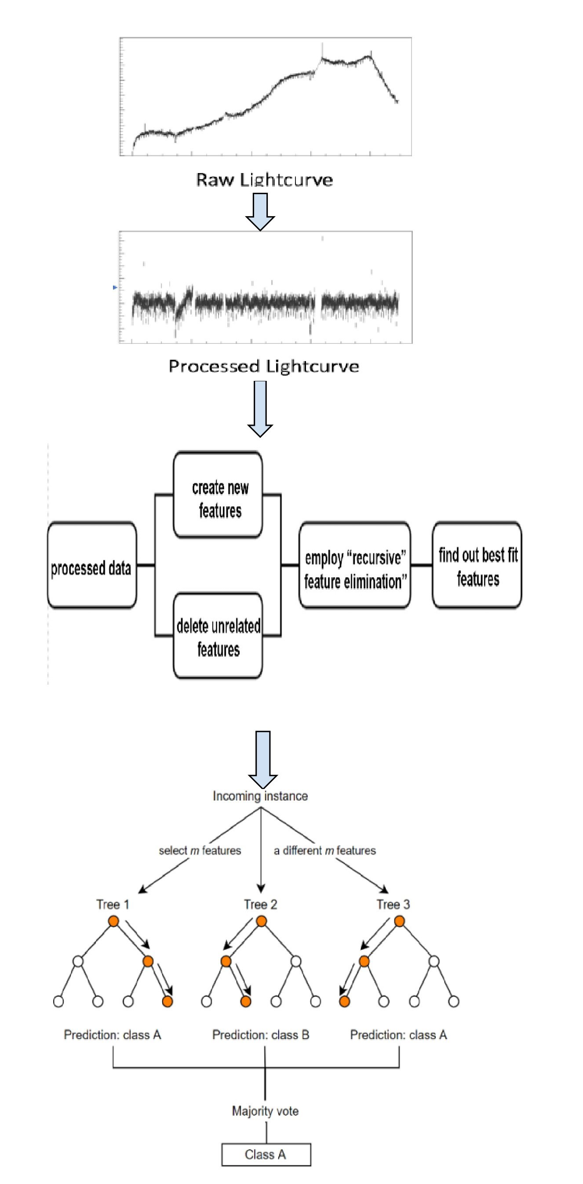
Work Flow

Slide 19
FLOWCHART
Data
Pre-processing
Model Training
Evaluation
Results.

Slide 20
MACHINE LEARNING MODELS
Models Explored:
Logistic Regression: Suitable for binary classification tasks.
K-Nearest Neighbors (KNN): Effective for datasets with clear class boundaries.
Decision Tree: Provides interpretability through tree-like decision structures.
Random Forest: An ensemble method enhancing accuracy and robustness.
Gradient Boosting: Sequential ensemble technique reducing bias and variance.
XGBoost: Optimized gradient boosting implementation for performance.
LightGBM: Gradient boosting framework designed for speed and efficiency.
Model Selection Criteria:
Ability to handle noisy data.
Computational efficiency.
Performance on imbalanced datasets.
Interpretability of results.

Slide 21
COMPARING KEPLER AND TESS PIPELINES
KEPLER:
Longer light curves
lower noise
more consistent data.
TESS:
Shorter light curves
Noisier
more feature engineering required.

Slide 22
MODEL INTRODUCTION 1
Random Forest
Ensemble model combining multiple decision trees.
Advantages:
Handles noisy data well.
Robust and interpretable.

Slide 23
MODEL INTRODUCTION 2
LightGBM
Gradient boosting model optimized for speed and efficiency.
Advantages:
Handles large datasets.
Fast training and prediction times.

Slide 24
MODEL INTRODUCTION 3
Gradient Boosting
Sequential ensemble model reducing bias and variance.
Suitable for imbalanced datasets.

Slide 25
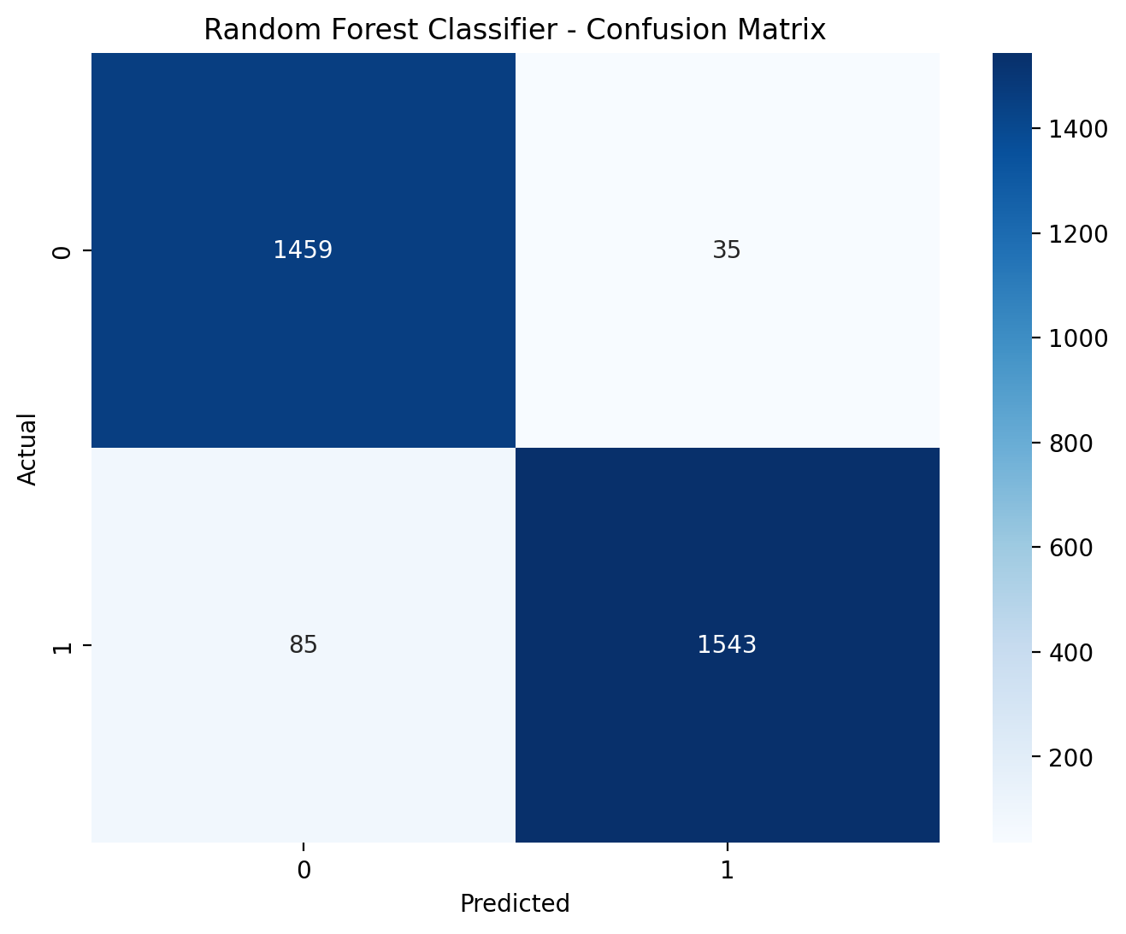
RESULTS
Kepler Results
Model: Random Forest Classifier
Accuracy: 96.16%
Recall: 94.78%
F1 Score: 96.26%
Precision: 97.78%

Slide 26
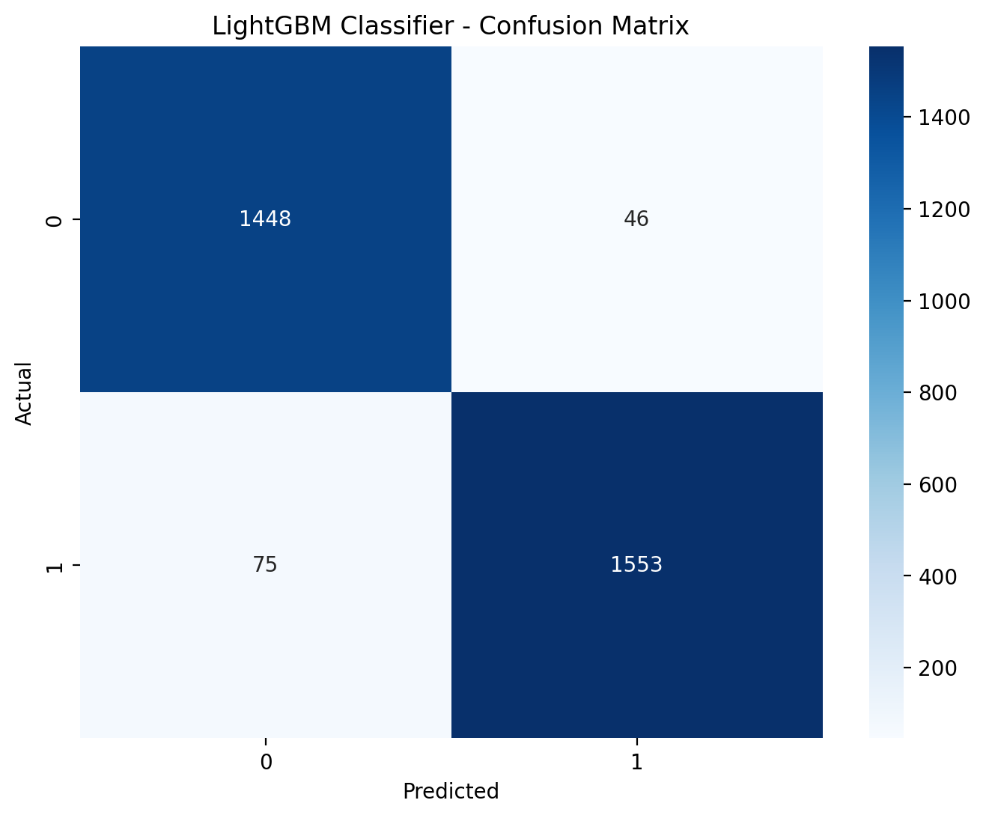
RESULTS
Kepler Results
Model: LightGBM Classifier
Accuracy: 96.12%
Recall: 95.39%
F1 Score: 96.25%
Precision: 97.12%

Slide 27
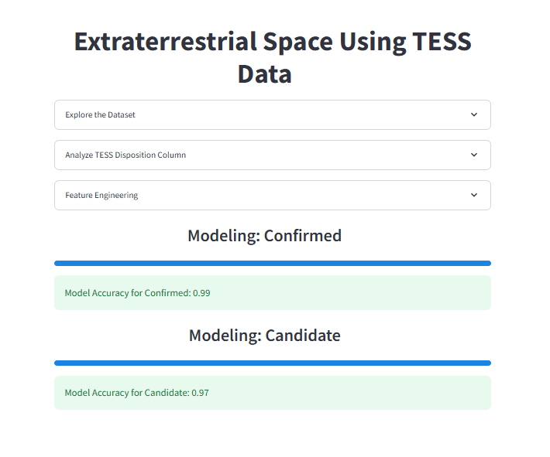
TESS RESULTS
Random Forest achieved
Model Accuracy for Confirmed: 99%
Model Accuracy for Candidate: 97%

Slide 28
CONCLUSION AND FUTURE WORK
Conclusion: Our machine learning models, particularly LightGBM and Random Forest, demonstrated excellent performance in detecting exoplanet candidates, achieving high accuracy, precision, and recall. Using the Orange tool for feature selection streamlined the process and enhanced model efficiency.
Future Work: We plan to apply this approach to larger datasets like TESS, improving model scalability. Additionally, exploring advanced feature selection methods and integrating real-time data will further enhance the system’s ability to detect exoplanets with greater precision and adaptability.

Slide 29
MINIMUM VIABLE PRODUCT
Try Here:- https://exoplanetdetection.streamlit.app/
MVP:- https://exoplanetmvp.streamlit.app/
Source Code:- https://github.com/Sandeepmopidevi/Exoplanet-Detection-in-Extraterrestrial-Space-Using-Machine-Learning

Slide 30
REFERENCES
Cite key papers and tools used in the project
Kepler and TESS datasets.
ML libraries (scikit-learn, LightGBM, etc.).
Hogg et al. (2018), Lai et al. (2020).
Nath-Ranga, R., Absil, O., Christiaens, V., & Garvin, E. O. (2024). "Machine Learning for Exoplanet Detection in High-Contrast Spectroscopy". Astronomy & Astrophysics.

Slide 31


